Slide 1
Accessibility: the land that time to interactive forgot
https://front-end.social/@tink

Slide 2
Web performance
The objective measurement and perceived experience of the time it takes a website to load and become interactive

Slide 3
Critical Rendering Path (CRP)
Paint
DOM
CSS Object Model
Render Tree
Layout

Slide 4
Paint
Paint

Slide 5
Paint
Paint

Slide 6
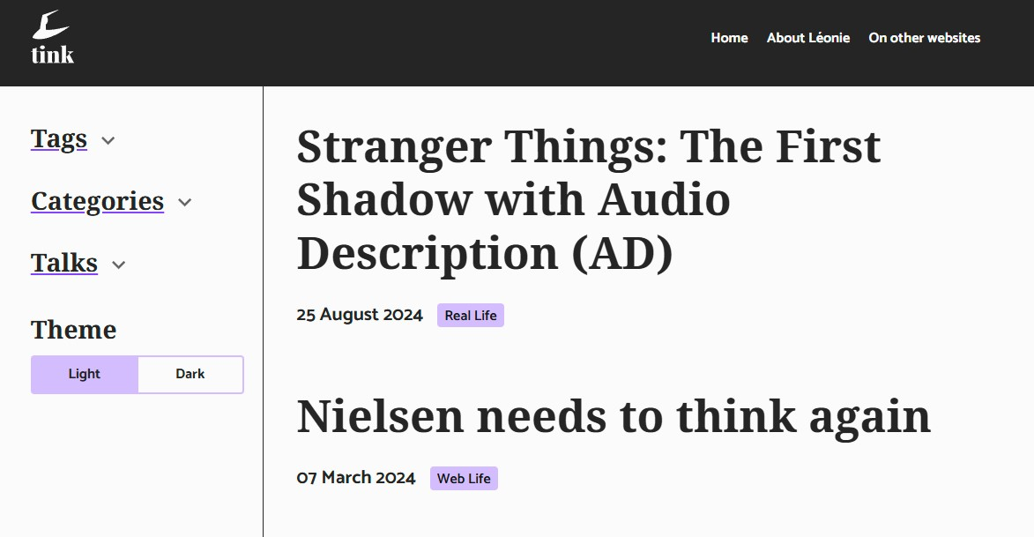

Paint
Paint

Slide 7
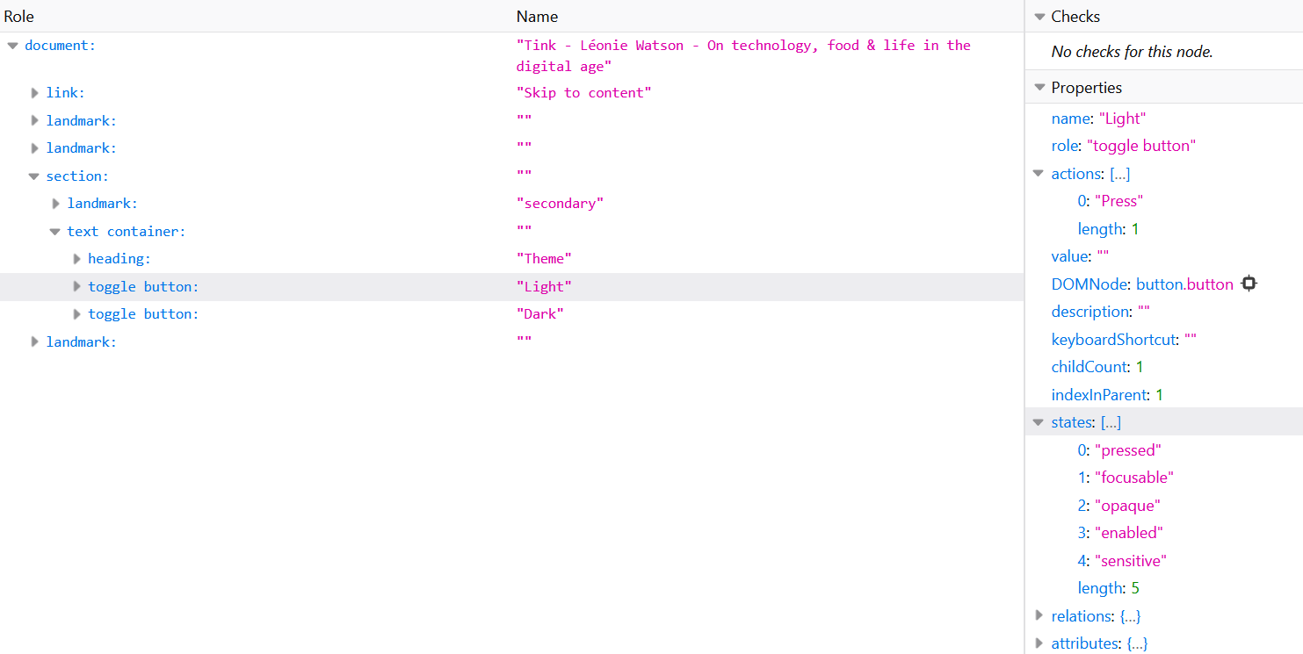
Accessibility tree

Slide 8
Semantics
HTML elements and attributes have implicit semantics

Slide 9
Role
An element’s role describes its purpose

Slide 10
The <button> element
<button></button>

Slide 11
Name
An element’s accessible name identifies it

Slide 12
The <button> element
<button>Show password</button>

Slide 13
State
An element’s state describes its current condition

Slide 14
The aria-pressed attribute
<button aria-pressed=“true“>Show password</button>

Slide 15
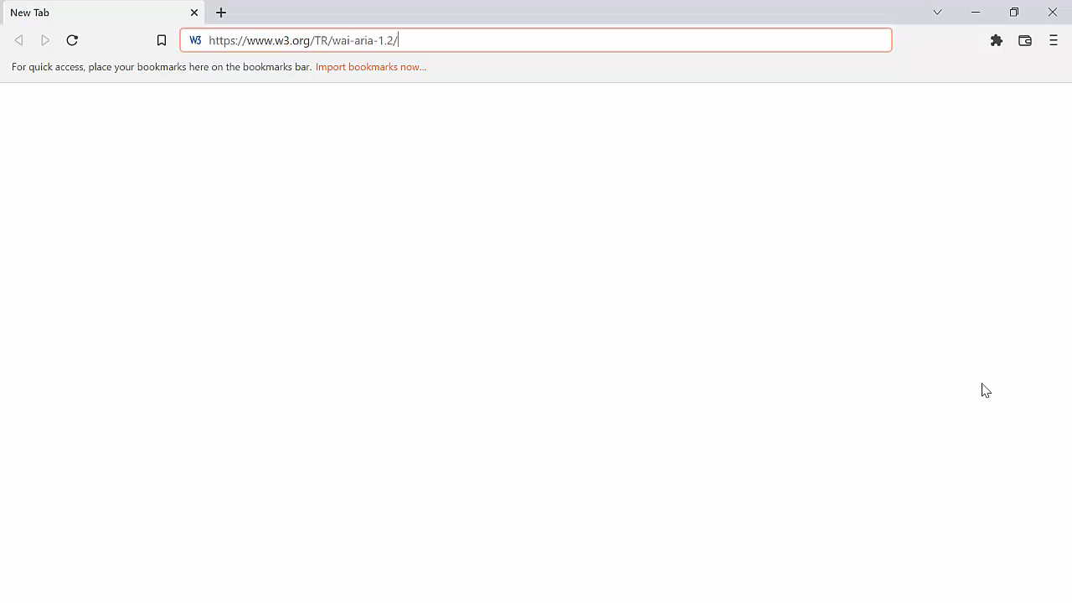
Wait for it…

Slide 16
Platform accessibility API
MSAA + Iaccessible
MSAA + IAccessible2
NSAccessibility Protocol
AT-SPI
UIAutomation

Slide 17
Single process model

Slide 18
Multi-process model
Application
Content

Slide 19

In process communication
Application
Content
Screen Reader

Slide 20
Out of process communication
Application
Content
Screen Reader

Slide 21
Internet Explorer -7
Application / Content
Screen Reader

Slide 22
Chrome and Firefox
Application
Content
Screen Reader

Slide 23
Chrome: initial approach
Proxied all API calls

Slide 24
Chrome: current approach
Caches the whole accessibility tree

Slide 25
Firefox: initial approach
Proxies API calls with intelligent caching

Slide 26
Firefox: current approach
Caches the whole accessibility tree

Slide 27
Safari
Application
Content
Screen Reader

Slide 28
Accessibility rendering path
DOM
CSS Object Model
Render Tree
Layout
Acc Tree

Slide 29
Rendering the accessibility tree
DOM
CSS Object Model
Layout
Acc Tree

Slide 30
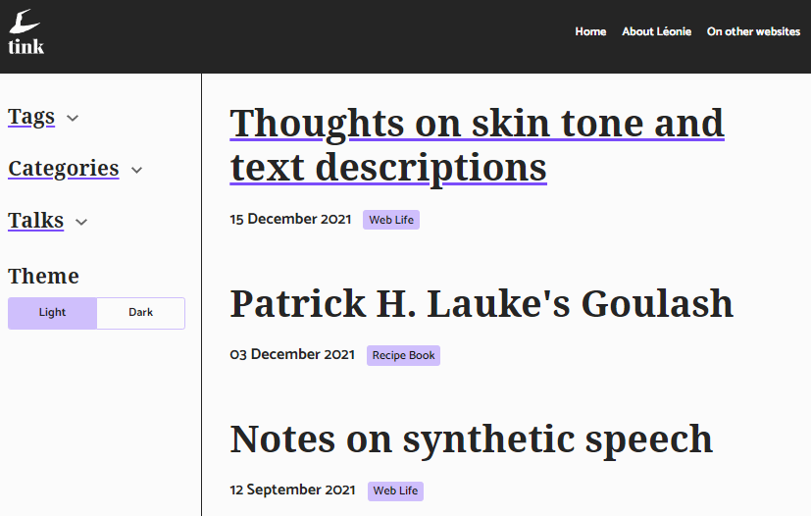
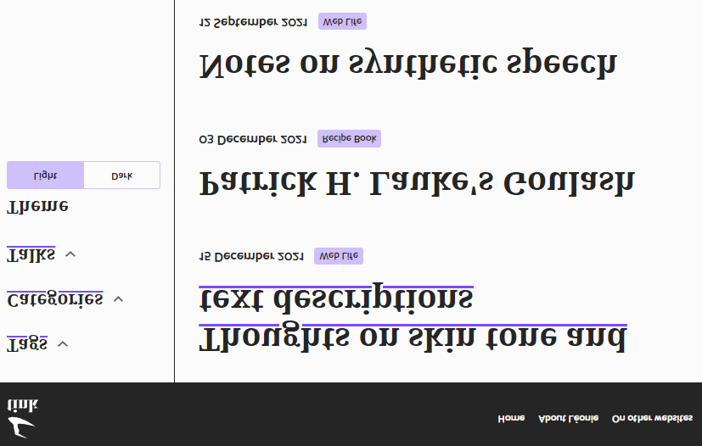
Virtual buffer

Slide 31
Element navigation
Paint

Slide 32
Perceived experience
Little things matter!

Slide 33
Objective measurements
https://github.com/GoogleChrome/lighthouse/issues/11049

Slide 34


Practical steps

Slide 35
Thank you
In particular to Glen Gordon, Jamie Teh, and Jeff Petty

